Slide 1


SVR ENGINEERING COLLEGE
DEPARTMENT OF CSE(ARITIFICIAL INTELLIGENCE)
A PROJECT ON
EFFECTIVE USAGE OF ARTIFICIAL INTELLIGENCE AND DEEP LEARNING FOR
IMPLEMENTING WEAPON DETECTION FOR SECURITY APPLICATIONS
PRESENTED BY :
RUHEENA TANVEER SHAIK(20AM1A3127)
M.VIGNESWAR REDDY (20AM1A3155)
SHASHIKALA.VANIPENTA (20AM1A3137)
UNDER THE GUIDANCE OF:
Mr.T.NIRANJAN BABU M.Tech(Ph.D)
Assistant Professor

Slide 2

CONTENTS
01
INTRODUCTION
02
ABSTARCT
03
EXISTING SYSTEM
04
PROPOSED SYSTEM
05
SYSTEM REQUIREMENTS
06
SYSTEM ARCHITECTURE
07
MODULES
08
SYSTEM DESIGN
09
CONCLUSION
10
REFERENCES

Slide 3

1.INTRODUCTION
Weapon or Anamoly detection is the identification of irregular, unexpected, unpredictable, unusual events or items, which is not considered as a normally occurring event or a regular item in a pattern or items present in a dataset and thus different from existing patterns. An anomaly is a pattern that occurs differently from a set of standard patterns.
Dataset is created, trained and fed to object detection algorithm. Based on application suitable detection algorithm (SSD or fast RCNN) chosen for detection. The approach addresses a problem of detection using various machine learning models like Region Convolutional Neural Network (RCNN), Single Shot Detection (SSD).

Slide 4

2.ABSTRACT
. Because crime rates are rising in crowded places and suspiciously isolated locales,
security remains a top priority in all fields. The principal uses of computer vision to address
a variety of issues include abnormal detection and monitoring.
Using Faster RCNN techniques, this research implements automatic detection of guns or other weapons. The two kinds of data used in the proposed solution. There was a pre-labeled image dataset and a manually labelled set of photos in the other dataset. The algorithms yield tabular results with good accuracy; however, the trade-off in speed and precision may determine how these algorithms are applied in practical scenarios

Slide 5
3.EXISTING SYSTEM
Abnormal detection and monitoring have major applications of computer vision to tackle various problems. Due to growing demand in the protection of safety, security and personal properties, needs and deployment of video surveillance systems can recognize and interpret the scene and anomaly events play a vital role in intelligence monitoring.
This project implements automatic gun (or) weapon detection using a convolution neural network (CNN).

Slide 6
DISADVANTAGES
Limited Spatial Context: CNN-based weapon detection systems typically rely on fixed-size convolutional kernels, which may limit their ability to capture spatial context effectively.
High Computational Complexity: Traditional CNN architectures used in the existing system often involve multiple layers with extensive parameter sets,leadingto high computational complexity during inference.
Efficient Real-Time Processing: FRCNN and SSD algorithms work swiftly, processing images in real-time without sacrificing accuracy.

Slide 7

4.PROPOSED SYSTEM
In Proposed implements automatic gun (or) weapon detection using based SS D and Faster RCNN algorithms. Proposed implementation uses two types of datasets. One dataset, which had pre-labelled images and the other one is a set of images, which were labelled manually.
Results are tabulated, both algorithms achieve good accuracy, but their application in real situations can be based on the trade-off between speed and accuracy.

Slide 8
ADVANTAGES
Enhanced Detection Accuracy: By employing advanced algorithms such as Faster R-CNN (FRCNN) and Single Shot Multibox Detector (SSD), the new system can pinpoint weapons more accurately.
Adaptability to Various Object Sizes: Unlike the traditional Convolutional Neural Network (CNN) used in the existing system, FRCNN and SSD algorithms can efficiently detect weapons of different sizes.
Efficient Real-Time Processing: FRCNN and SSD algorithms work swiftly, processing images in real-time without sacrificing accuracy.

Slide 9



5. SYSTEM REQUIREMENTS
HARDWARE REQUIREMENTS
Processor - Intel i3 or i5
Speed - 2.4 GHz
RAM - 8 GB (min)
Hard Disk - 256 GB (min)
SOFTWARE REQUIREMENTS
Operating System - Windows 10 or above
Programming Language - Python (3.7.4)
Tools - OpenCV

Slide 10

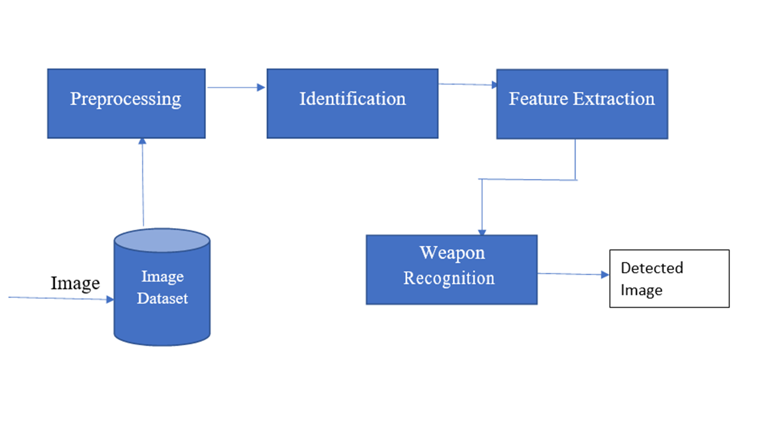
6.SYSTEM ARCHITECTURE

Slide 11

7.MODULES
7.1 Upload weapon dataset
7.2 Generate and Load Weapon Detection Model
7.3 Upload Test Image
7.4 Detect Weapon From Test Image
7.5 Detect Weapon From Video
7.6 Detect Weapon From Webcam
7.7 FRCNN Accuracy and Loss Graph

Slide 12


7.1 Upload Weapon Dataset
Gather a diverse and balanced dataset for robust model training.
Include images of various firearm and bladed weapon types.
Ensure diversity in scenarios: indoor, outdoor, low light, and varying backgrounds.
Annotate images with bounding boxes to denote weapon locations.
Clean and preprocess the dataset to remove outliers and ensure consistency.

Slide 13

7.2 Generate and Load Weapon Detection Model
Choose a pre-trained FRCNN or initiate model training like SSD from scratch using a deep learning framework.
Implement data augmentation techniques (rotation, flipping, scaling) to enhance model generalization.
Fine-tune hyperparameters for optimal performance.
Integrate the model into the system, ensuring seamless loading for subsequent use.

Slide 14


7.3 Upload Test Image
Design a clear and intuitive interface for users to upload test images easily.
Support multiple image formats to accommodate user preferences.
Include error handling for invalid file types or corrupted images.
Provide feedback on successful image upload.

Slide 15
7.4 Detect Weapon From Test Image
Preprocess the uploaded image for compatibility with the model.
Implement the FRCNN model to identify and annotate detected weapons.
Display the results with bounding boxes and confidence scores.
Ensure real-time responsiveness for quick feedback.

Slide 16

7.5 Detect Weapon From Video
Utilize video processing libraries like OpenCV for frame-by-frame analysis.
Optimize processing speed for real-time performance.
Implement object tracking algorithms to follow weapons across frames.
Provide options for live video input or processing pre-recorded videos.

Slide 17
7.6 Detect Weapon From Webcam
Weapon detection from webcams can be employed in various security settings such as airports, train stations, and public venues to enhance security measures.
Real-time weapon detection from webcams can aid law enforcement agencies in identifying and apprehending individuals involved in criminal activities.
In emergency situations such as active shooter incidents or terrorist attacks, weapon detection systems integrated with webcams can provide timely alerts to authorities, enabling swift response and evacuation procedures to safeguard lives.

Slide 18
7.7 FRCNN Accuracy and Loss Graph
Utilize visualization tools like TensorBoard or Matplotlib.
Display accuracy and loss curves during training epochs.
Include additional metrics (precision, recall, F1 score) for comprehensive evaluation.
Provide insights into the learning curve and convergence of the model.

Slide 19
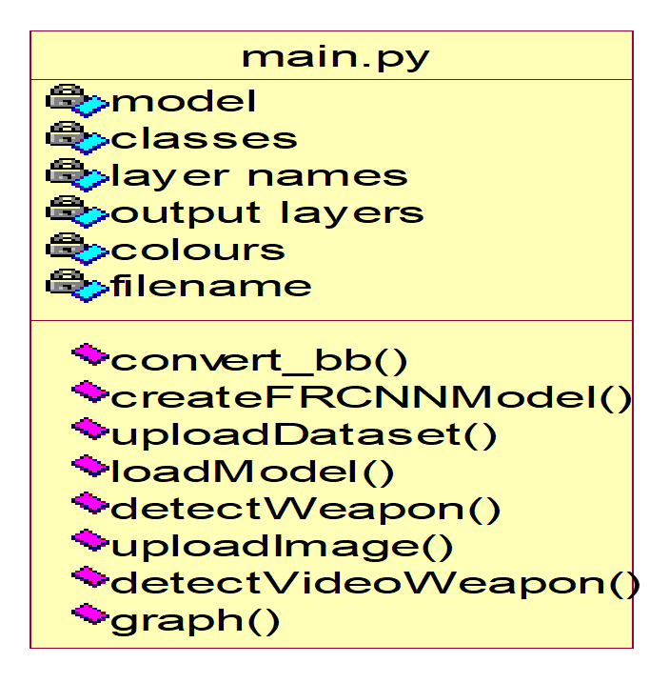
8.SYSTEM DESIGN

Slide 20
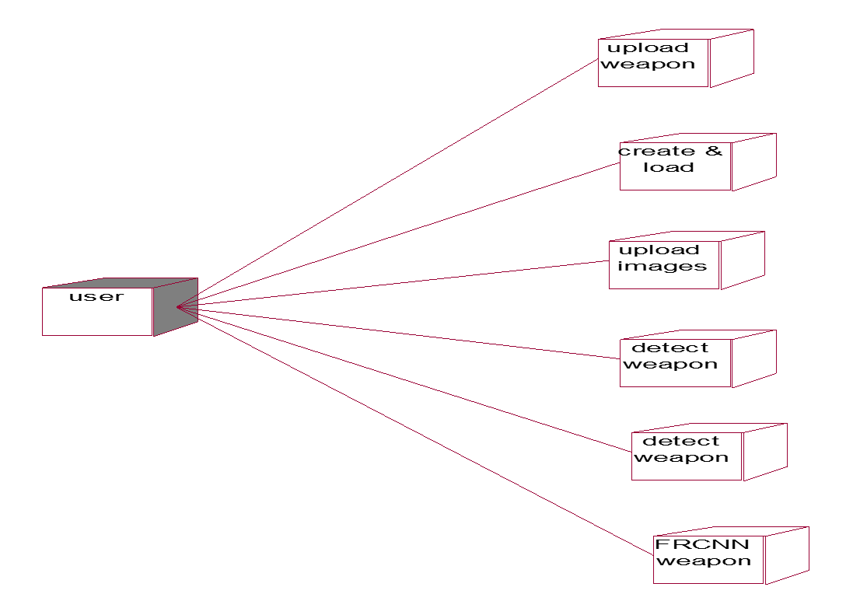
8.1 DEPLOYMENT DIAGRAM

Slide 21
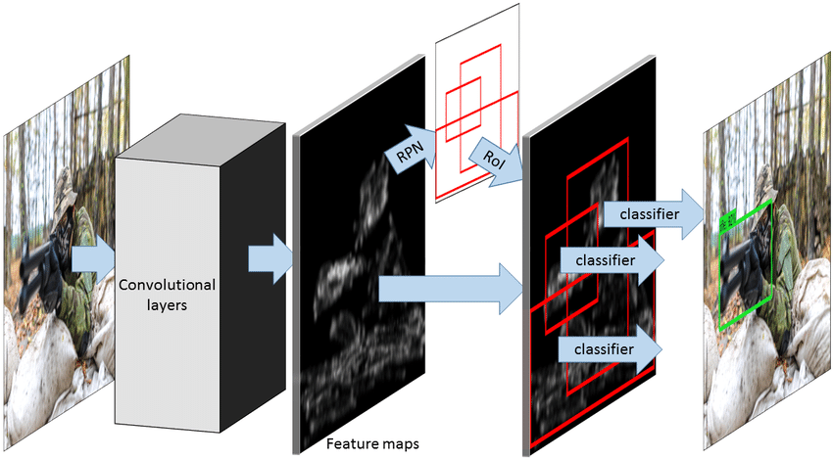
8.2 CONVOLUTIONAL NEURAL NETWORK(CNN)
A convolutional neural network (CNN or ConvNet) is a network architecture for deep learning that learns directly from data.
CNNs are particularly useful for finding patterns in images to recognize objects, classes, and categories.

Slide 22
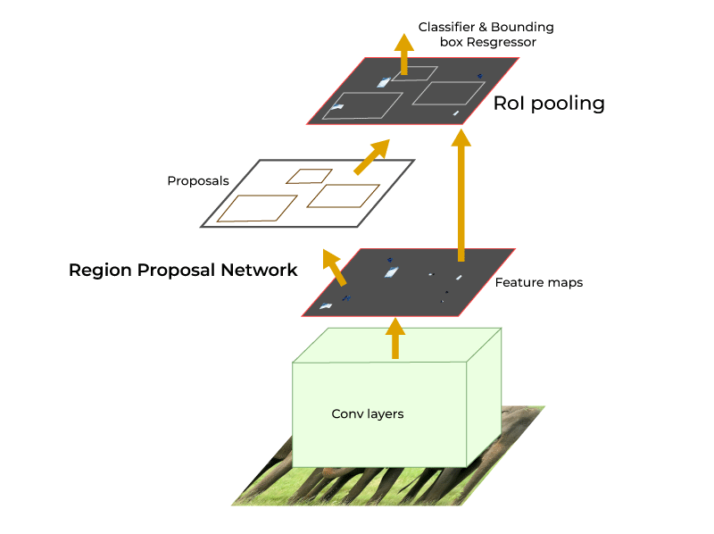
8.3 FASTER REGION-CONVOLUTIONAL
NEURAL NETWORK(F-RCNN)
A Faster R-CNN network is a convolutional neural network based object detector.
To train the creatednetwork,use the train FasterRCNN Object Detector function.

Slide 23
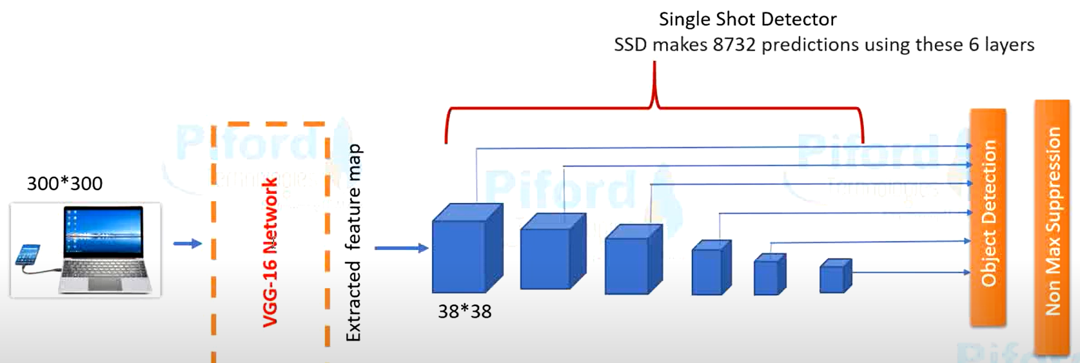
8.4 SINGLE-SHOT DETECTOR(SSD)
The Single Shot MultiBox Detector (SSD) is a robust object detection framework based on a feed-forward convolutional neural network (CNN).

Slide 24
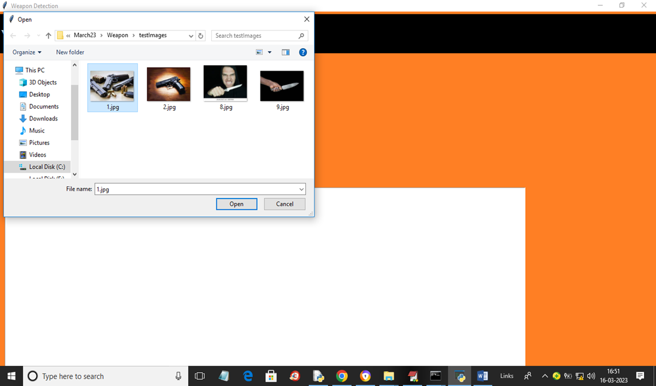
8.5 RESULTS
8.5.1Detecting Weapon From Images

Slide 25
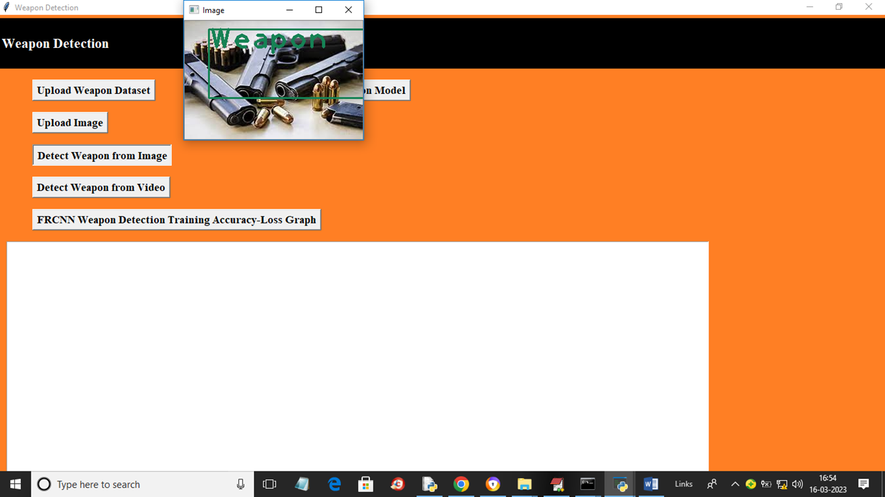
8.5.2 Detecting Weapon From Videos

Slide 26
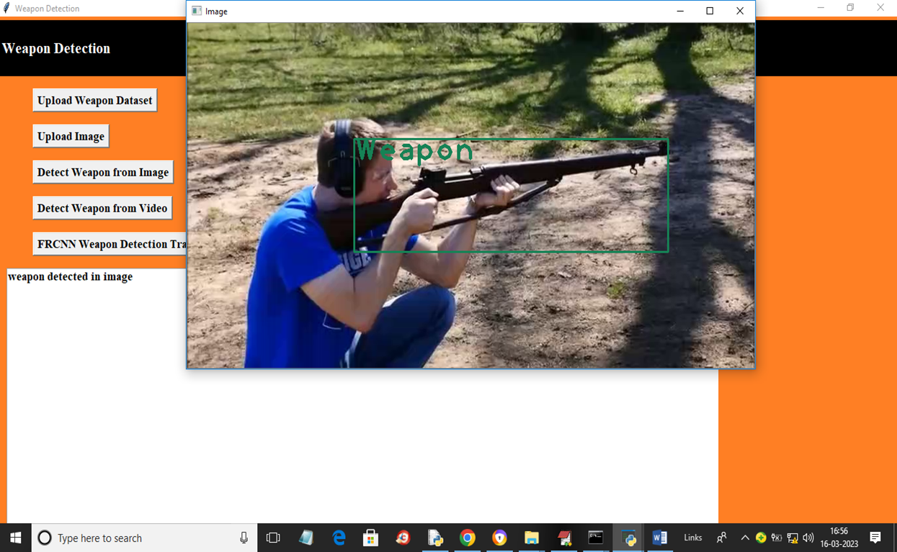
8.5.3 Detecting the Weapon

Slide 27
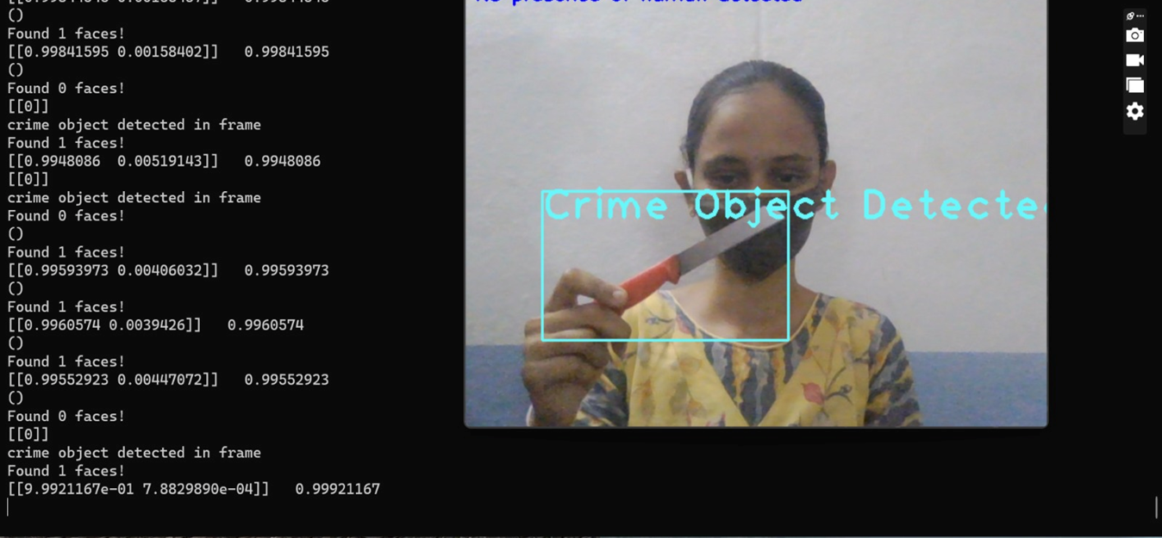

Slide 28
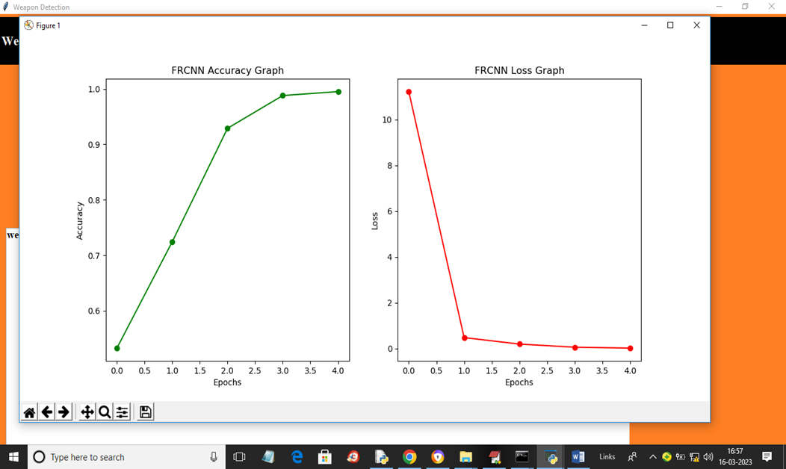
8.5.6 FRCNN Weapon Detection Training Accuracy-Loss Graph

Slide 29
9. CONCLUSION
SSD and Faster RCNN algorithms are simulated for pre labeled and self-created image dataset for weapon (gun) detection.
Both the algorithms are efficient and give good results but their application in real time is based on a tradeoff between speed and accuracy.
In terms of speed, SSD algorithm gives better speed with 0.736 s/frame. Whereas Faster RCNN gives speed 1.606s/frame, which is poor compared to SSD.
With respect to accuracy, Faster RCNN gives better accuracy of 84.6%. Whereas SSD gives an accuracy of 73.8%, which is poor compared to faster RCNN.
SSD provided real time detection due to faster speed but Faster RCNN provided superior accuracy. Further, it can be implemented for larger datasets by training us ing GPUs and high-end DSP and FPGA kits.

Slide 30
10. REFERENCES
[1] Wei Liu et al., “SSD: Single Shot MultiBox Detector”, European Conference on Conputer Vision, Volume 169, pp 20-31 Sep. 2017.
[2] D. Erhan et al., “Scalable Object Detection Using Deep Neural Networks,” IEEE Conference on Computer Vision and Pattern Recognition(CVPR),2014.
[3] Ruben J Franklin et.al., “Anomaly Detection in Videos for Video Surveillance Applications Using Neural Networks,” International Conference on Inventive Systems and Control,2020.
[4] H R Rohit et.al., “A Review of Artificial Intelligence Methods for Data Science and Data Analytics: Applications and Research Challenges,”2018 2nd International Conference on I-SMAC (IoT in Social, Mobile, Analytics and Cloud), 2018.

Slide 31
[5] Abhiraj Biswas et. al., “Classification of Objects in Video Records using Neural Network Framework,” International conference on Smart Systems and Inventive Technology,2018.
[6] Pallavi Raj et. al.,“Simulation and Performance Analysis of Feature Extraction and Matching Algorithms for Image Processing Applications” IEEE International Conference on Intelligent Sustainable Systems,2019.
[7] Mohana et.al., “Simulation of Object Detection Algorithms for Video Survillance Applications”, International Conference on I-SMAC (IoT in Social, Mobile, Analytics and Cloud),2018.
[8] YojanChitkara et. al.,“Background Modelling techniques for foreground detection and Tracking using Gaussian Mixture model” International Conference on Computing Methodologies and Communication,2019.

